Slide 1

Structure and Dynamics Research Laboratory
Research Meet | June 5, 2023
INSTALLING
QUANTUM ESPRESSO
MacOS Terminal
Ana Clarissa D. Torio
III - BS Applied Physics
Notes:
Good day everyone!
I am Ana Clarissa Torio from the Computational Materials Physics Group and Our research adviser is dr. macam
Since our fields of interest are inclined toward materials modeling, structures, and properties, we have been familiarizing ourselves with using quantum espresso and aloso in programming with linux. This will prepare us for our thesis ideation and writing in the next few months. or the next semester
so in this case, i would be giving a presentation on installing quantum espresso using the macos terminal

Slide 2



MacOS Terminal
Background
How is it different from other operating systems
Quantum Espresso
Installation
Packages
Steps
Errors
Table of
Contents
Sample Calculations
Notes:
to fulfill the goal oof this presentation, these would be the contents. The dfirst is a brief background...

Slide 3




About the
MacOS Terminal
Unix-based operating system
Web and database servers are Unix as well
MacOS X (2001): Darwin operating system (public source code)
Usage of Z shell (zsh) as the command line interface
Bourne-again shell for older versions, same with Linux
Better configuration and features
Direct installation of Quantum Espresso
Made for Unix systems (Linux and MacOS)
Windows Counterpart
Usage of PowerShell, with the Command Prompt as the command line interface
Notes:
Unix: umbrella term
Darwin is like a sub-category under that that is being distributed with MacOS softwares

Slide 4

More about
QUANTUM ESPRESSO
A suite of open-source codes for electronic-structure calculations and materials modeling
Density Functional Theory (DFT)
Electronic structures and properties
Molecular dynamics
Stress and strain modeling
Structure optimization
Written in Fortran, works in Unix environments (bash, zsh)
Notes:
Fortran programs can be run in Unix systems (linux, Darwin)
Fortran compilers are also readily available for unix systems, making it easyly executable

Slide 5

A GUIDE FOR
INSTALLATION (V7.2)
STEPS
PACKAGES

Slide 6


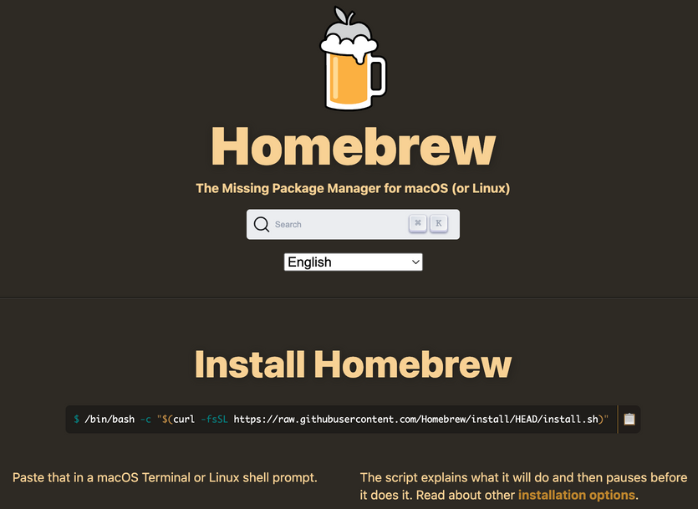
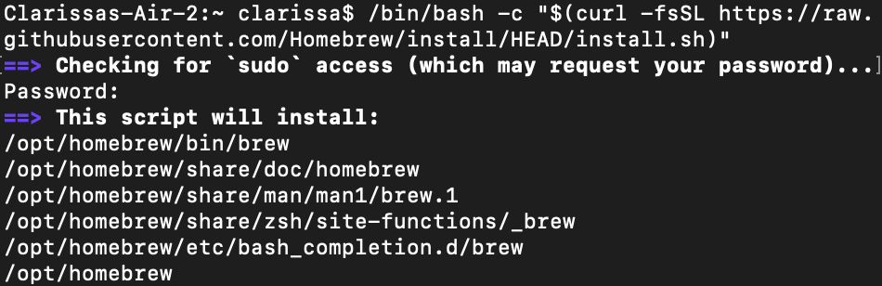
Installing the
Homebrew package manager (brew.sh)
brew commands
for installing compilers (brew install), updating packages (brew update), update all packages (brew upgrade)

Slide 7
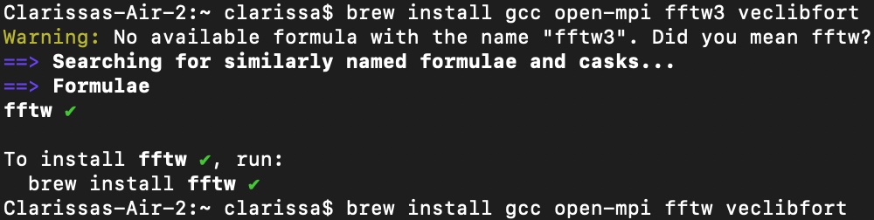

Packages
you need
GCC
OPEN-MPI
FFTW3
VECLIBFORT
GNU Compiler Collection
support for Fortran
source code -> bytes
Open Message Passing Interface
for parallel computing
Fast Fourier Transform in the West
basis sets, structures and properties calculations
Fortran compatible version of VecLib
Vector computations
brew install gcc
brew install open-mpi
brew install fftw
brew install veclibfort

Slide 8
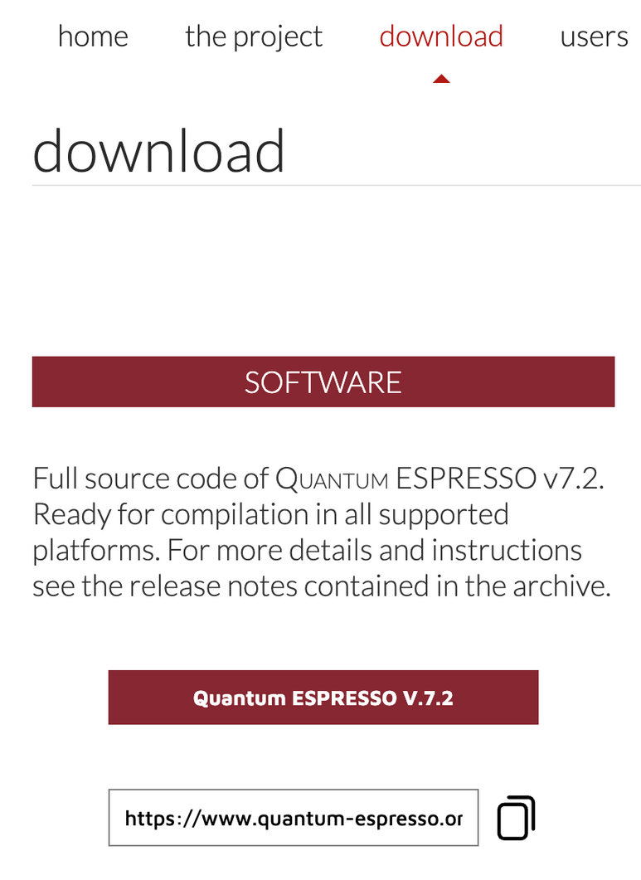

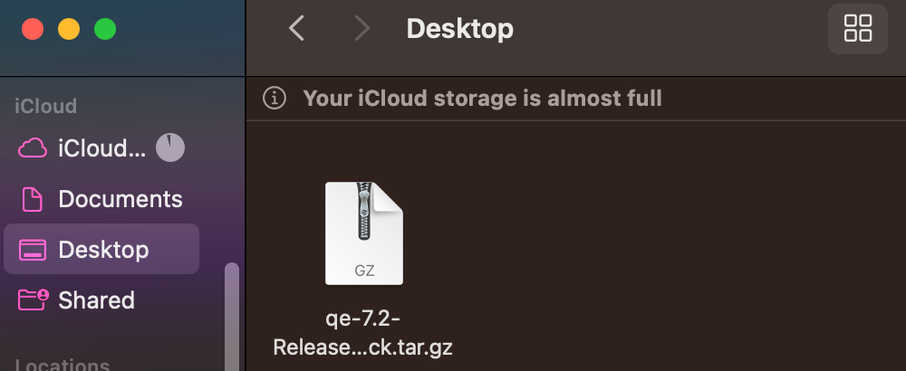
Downloading and extracting
Quantum ESPRESSO
from quantum-espresso.org
tar -zxvf qe-7.2-ReleasePack.tar.gz
tar.gz is a zipped file containing all the source code of Quantum ESPRESSO version 7.2. This would be extracted using tar -zxvf
Access quantum-espresso.org
Under Downloads, register an account
Upon logging in, you can access the Downloads with a list of versions
After choosing a version, click the
Quantum ESPRESSO V.X.Y button to download
the tar.gz file

Slide 9
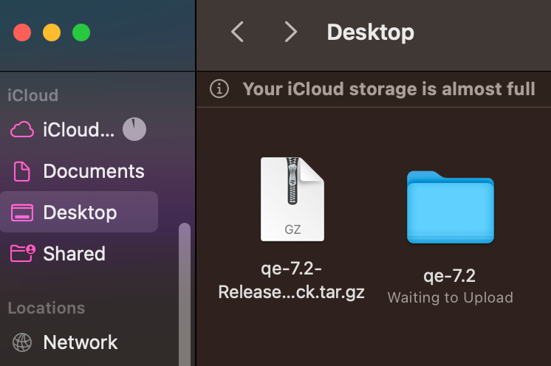

Downloading and extracting
Quantum ESPRESSO
from quantum-espresso.org
tar -zxvf qe-7.2-ReleasePack.tar.gz
tar.gz is a zipped file containing all the source code of Quantum ESPRESSO version 7.2. This would be extracted using tar -zxvf
Success!

Slide 10

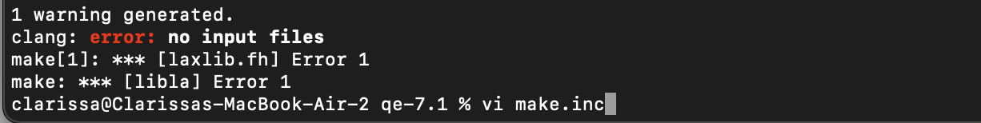
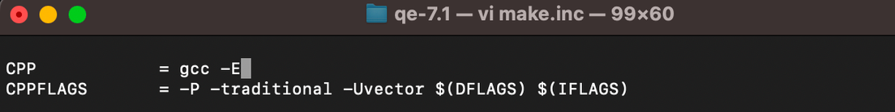
Configuring the QE directory
cd qe-7.2
Go to the qe-7.2 directory
./configure
Configure (yields make.inc file)
continuing without editing the make.inc file first will result to an error in the next step
CPP = gcc -E
Resolve error: redefine CPP in make.inc as

Slide 11
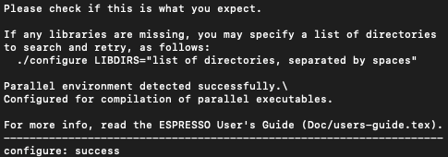
Configuring the QE directory
cd qe-7.2
Go to the qe-7.2 directory
./configure
Configure (yields make.inc file)
Success!
CPP = gcc -E
Resolve error: redefine CPP in make.inc as

Slide 12

Compiling packages
make [-j N] pw
Compiling and creating executables needed to run calculations
cmake instead of make could be used depending on the installed package
to check if the compilation is successful, the bin folder should have executable file contents
For compiling only the PWscf package
make [-j N] all
For compiling ALL packages. [-j N] executes the compilation in parallel for N processors. No need to add for series compilation

Slide 13
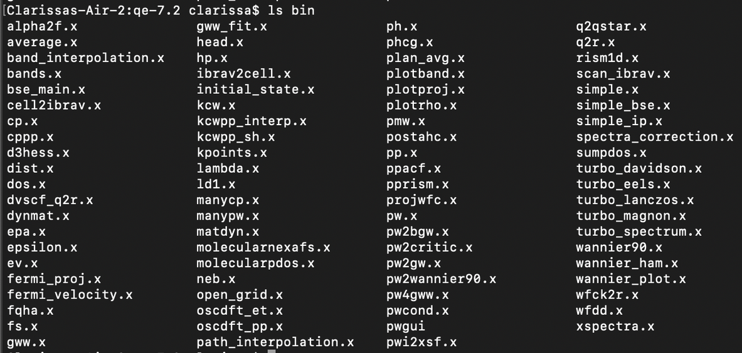
Compiling packages
Compiling and creating executables needed to run calculations
cmake instead of make could be used depending on the installed package
to check if the compilation is successful, the bin folder should have executable file contents

Slide 14

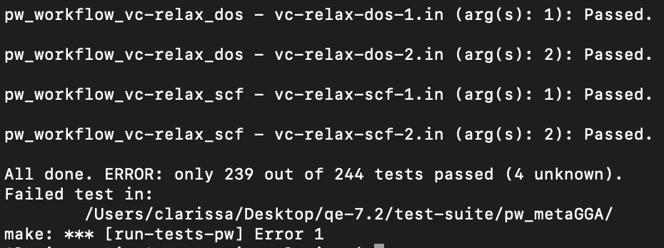
Testing for executables for verification
cd test suite
the test suite is a directory containing validation tests to check which packages are erroneous or missing
make run-tests
execute/run test suite
The expected output should yield "Passed" in the packages or executables being tested
In cases that the packages yield error, the error message specifies missing dependencies or any incompatibilities
Notes:
Failed test for MetaGGA may not pose any problems with the calculations involving scf, which I have already done
but for other calculations that needs this specific package, it may yield to errors or unsuccessful calculations.
To help adress this, it may be effective to reinstall with later or previos versions, depending on your suystem's compatibility, as well as downloading the packages individually through repositorues

Slide 15

Some reminders...
ENVIRONMENT CONFLICTS
SETTING PATH
COMPILERS
Interfering with Anaconda environment
QE installation may lead to errors
Add QE to the PATH
Allows QE to be executable from whichever directory
You may select a parallel compiler (mpif90)
Disable parallel and enable serial
echo 'export PATH="/root/qe-7.2/bin:$PATH"' >> ~/.bashrc
./configure --disable-parallel
./configure --enable-openmp
Notes:
its possible tfor QE to be in conflict with other environments installed in your device (such as anaconda)
and with personal experience, the anaconda environment is also set to my system's path, therefore mixups with compilers are possible, leading to errors.

Slide 16
RUNNING
SAMPLE CALCULATIONS
TROUBLESHOOTING
SCF

Slide 17

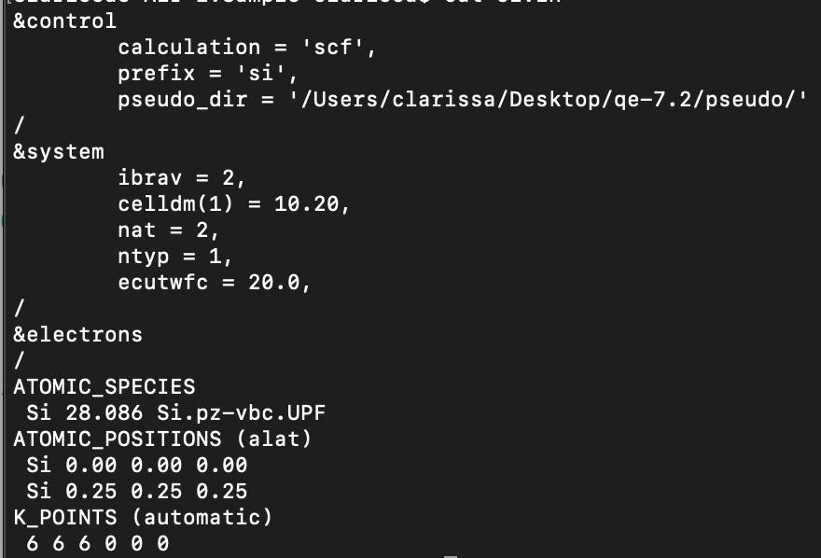
vi si.in
opening the text file named si.in that will then become the input file for the SCF calculation
Adding the contents of the input file
setting the type of calculation, material specifications, and other parameters
Self consistent field calculation (SCF) for silicon
Notes:
the SCF calciuilation is used to solve the kohn-sham equations through an input file. This could then be used to yyield calculated total energies, electronic band structures, and other properties.

Slide 18
vi si.in
opening the text file named si.in that will then become the input file for the SCF calculation
Adding the contents of the input file
setting the type of calculation, material specifications, and other parameters
&control: type of calculation and location of the pseudopotential file (also used to set the output file location through outdir and filename through prefix)
&system: lattice and structure parameters
&electrons: adjust iterations, factors, and thresholds involving electron calculations
ATOMIC_SPECIES: material or atomic species involved, addition of pseudopotential file
ATOMIC_POSITIONS: coordinates of elements and atoms
K_POINTS: grid and shift for sampling (through Monkhorst–Pack method)

Slide 19
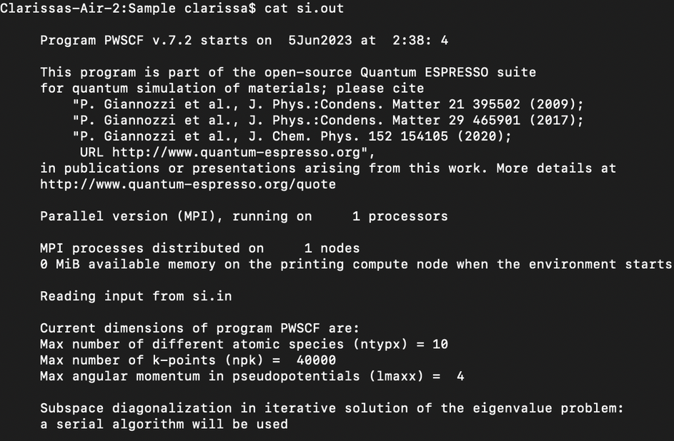
pw.x -inp si.in > si.out
running the executable file (pw.x)
cat si.in
viewing the contents of the output file
Self consistent field calculation (SCF) for silicon

Slide 20
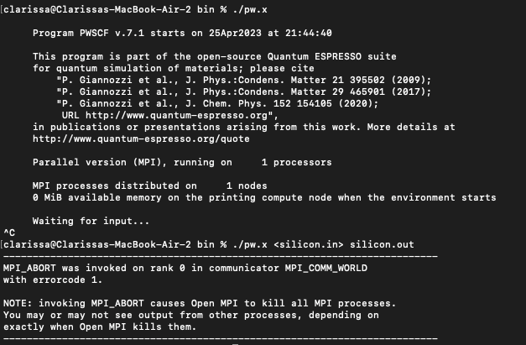
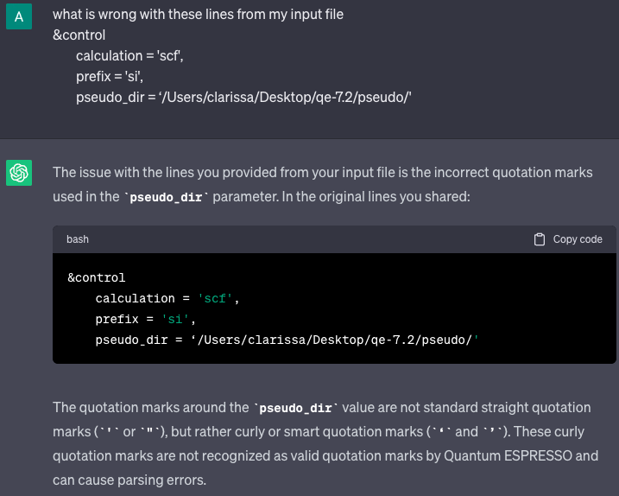
Errors encountered
In this case, the input text file had erroneous contents (curly quotation marks should be replaced with normal quotation marks, ‘ vs. ')
Resources for checking errors
Aside from Stack Overflow and mail-archive.com, one could also use ChatGPT (responsibly) for checking errors. Here is a sample prompt:
Self consistent field calculation (SCF) for silicon

Slide 21
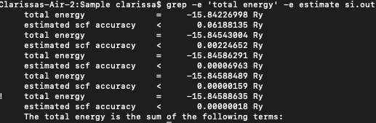
grep -e 'total energy' -e estimate si.out
finding lines within the output file that satisfies "total energy," or "estimate." This can be used to find how convergence is reached
grep -e level si.out
It is expected to find the highest occupied level and lowest unoccupied level, then use the results to find the band gap (difference)
Self consistent field calculation (SCF) for silicon

Slide 22
References
Behery, A. (2022, December 13). Linux Shells Explained. FreeCodeCamp. https://www.freecodecamp.org/news/linux-shells-explained/
Andrade, F. (2022, August 29). Is a Mac or Windows PC Better for Programming? GeekCulture. https://medium.com/geekculture/is-a-mac-or-windows-pc-better-for-programming-d5556bf06f1
Trent, M., & McCormack, D. (2005). Beginning Mac OS® X Programming. Wrox
Giannozzi, P., et al. (2009). Quantum ESPRESSO: a modular and open-source software project for quantum simulations of materials. Journal of Physics: Condensed Matter, 21(39), 395502. DOI: 10.1088/0953-8984/21/39/395502
Quantum ESPRESSO. (2022). Quantum ESPRESSO User Guide (v.7.0.). Quantum ESPRESSO. https://www.quantum-espresso.org/wp-content/uploads/2022/03/user_guide.pdf
Homebrew. (n.d.). Homebrew Formulae. https://formulae.brew.sh/
Quantum ESPRESSO. (n.d.). Pseudopotentials. Quantum ESPRESSO. https://www.quantum-espresso.org/pseudopotentials/
QuantumNerd. (2019, June 23). Quantum Espresso Tutorial 2019: 5. How to run / input file [Video]. YouTube. https://www.youtube.com/watch?v=mQ1D3tXWqD4
Materials Square. (2019, January 1). Convergence Test: K-Points Optimization for Silicon Bulk. Materials Square. https://www.materialssquare.com/blog/2-convergence-test-k-points-optimization-for-silicon-bulk-2#:~:text=In%20Quantum%20Espresso%2C%20selecting%20the,point%20mesh%20of%20each%20axis
Das, P. (n.d.). Self consistent field calculation for silicon. GitHub Pages. https://pranabdas.github.io/espresso/hands-on/scf

